Slide 1
Alligator PFAS Study: Non-Targeted Analysis
December 2024

Slide 2

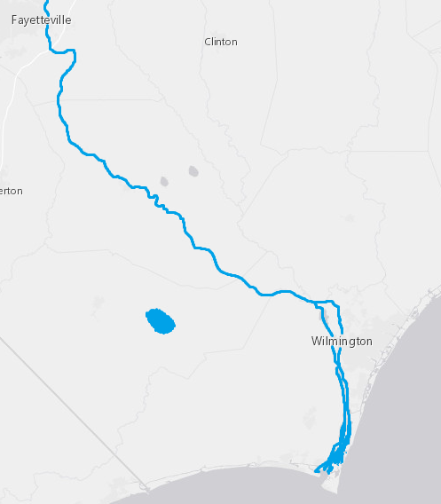

Experimental Design
Extract 200 plasma samples along with blanks, QCs, calibration curve (Completed March 2023)
Analyze using ESI(-) LC-IMS-MS
Analyze a subset using CID-MS in (-) and (+)
Perform target screening for 100 PFAS using in-house library and Skyline
Quantify up to 26 PFAS using cal curves in Skyline
Identify non-target suspect PFAS using IM-MS Browser, Mass Profiler, Fluoromatch, and Greg’s proprietary new tool
A
Lake Waccamaw
B
Cape Fear River
#C2FFE0
C
Coastal NC
A
#006600
B
D
Florida
C
#CC9900
D
#800080

Slide 3
Methods
Generate feature list in Agilent Mass Profiler
Score features using Fluoromatch-IM
Reduce data and prioritize features using Greg’s tool
Investigate features -> did we find any new PFAS?
Compare feature abundance and detections over time at each site

Slide 4
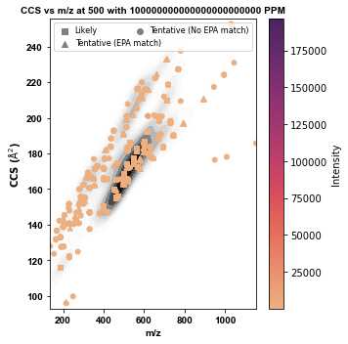
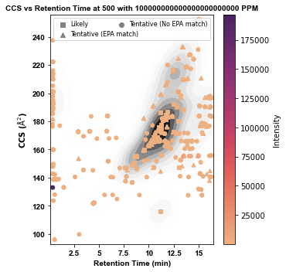
Results: Feature finding and initial prioritization
MassProfiler results: 8,958 features
After processing with Greg’s tool: 242 features
31 “likely” (m/z and CCS match to library)
62 tentative with an m/z match to EPA library
149 tentative, no library match

Slide 5
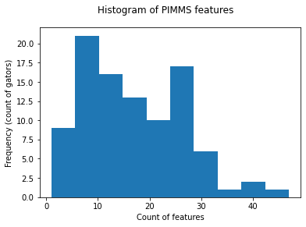
Descriptive statistics of unvalidated features
Mean: 16.8 features/gator, SD 9.8
Median: 15.5 features/gator
Min: 1 feature/gator
Max: 47 features/gator

Slide 6
Validation of PFAS-like features

Slide 7
Additional processing and feature prioritization
Excluded all features that matched m/z, CCS, and RT of a PFAS already in our library
Excluded all features with RT < 2 min
Excluded noisy features and those present in blanks (visually checked all relevant samples and blanks by loading feature list into Skyline)
14 features remained and were manually annotated
2 features (ID# 2130 and 747): br-PFUdA (M-H- and M-H-CO₂-), level 3 confidence
1 feature (ID# 5849): PFPeDA, level 2 confidence
1 feature (ID# 4751): U-PFOS, level 3 confidence
7 features (ID# 1413, 1692, 6811, 2216, 3511, 1159, 331): Not ID’ed, level 5 confidence
2 features (ID# 2318 and 2857): New additions to PFEESA homologous series, PFHxESA and PFHpESA, level 2 confidence
1 feature (ID# 5135): Investigation resulted in 3 novel PFAS (level 3 confidence) and 2 additional features of interest (level 5 confidence)

Slide 8
Long chain PFESAs detected in alligators
Detected in gators
Detected in SPATTs
Reference standard value in our library
Feature ID# 1692
Confidence level: 5
Unidentified
Exact m/z match to PFEESA, wrong RT, wrong CCS
PFHxESA (Feature ID# 2318)
Confidence Level: 2
Molecular Formula: C₈HF₁₇O₄S
[M-H]-: 514.925131 Da
PFHpESA (Feature ID# 2857)
Confidence Level: 2
Molecular Formula: C₉HF₁₉O₄S
[M-H]-: 564.921938 Da

Slide 9
Feature ID# 5135 – m/z 448.9655
Identification: H-substituted polyfluoroether alcohol?
Confidence level: 3
Novel PFAS? (see next slide…)
MS2 Fragments:
m/z 282.9822
m/z 262.9760

Slide 10
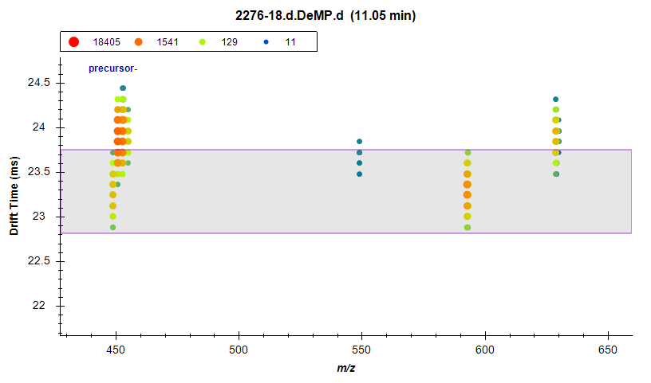
m/z 592.959 drift aligned with feature ID# 5135
Strong correlation in peak areas of these two features
448.9655 + CO₂C₂F₄ = 592.9495
Identification: H-substituted polyfluoroether alcohol
Confidence level: 3
Novel PFAS
Post source decay of m/z 592.9495?
Metabolite of m/z 592.9495?
m/z 448.9677
m/z 592.9495

Slide 11
Possible structures for m/z 592.9481
Comparison to novel SPATT compounds:
m/z 448.9676 observed as a fragment of compounds 9 & 10 (multi-headed perfluorinated ethers)
Kaylie’s paper suggested that an H-substitution of a carboxylic acid group is plausible and has been reported elsewhere, though that wasn’t detected in the SPATTs
Identification: H-substituted perfluoro triether carboxylic acid
Confidence level: 3 (fragments cannot distinguish between isomers)
Novel PFAS

Slide 12
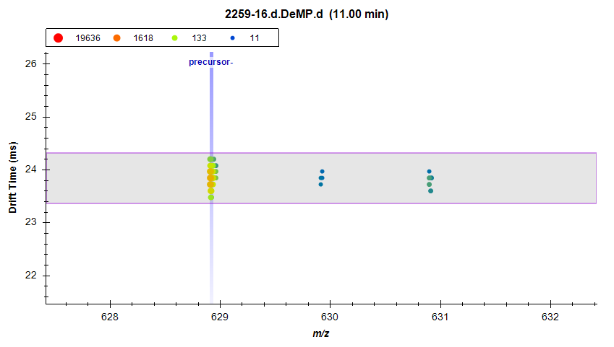
m/z 628.9189
Kaylie’s compound 10 with loss of a COOH
Compound 10 not detected in gators
Fragments: 282.9931, 262.9749 118.9707, 82.9619
Another possible structural isomer
No Pubchem entries match this formula
Perfluorinated ether sulfonic acid
C10H2F20O6S M-H-
Confidence level: 3
Novel PFAS

Slide 13
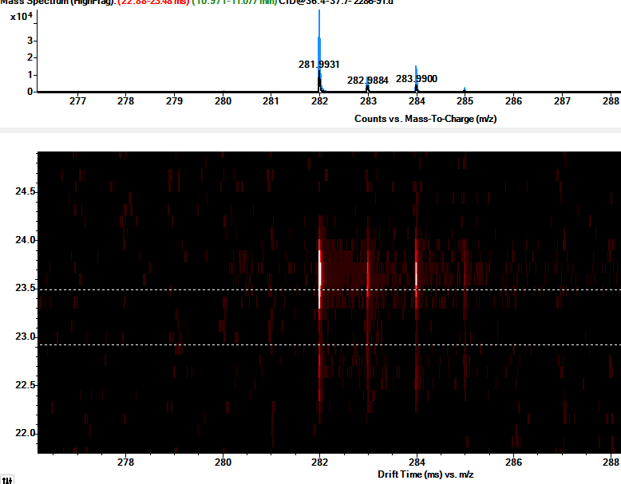
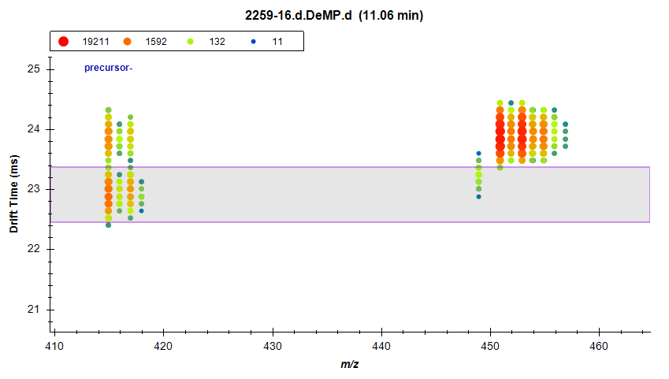
Additional features m/z 450.9280 and 414.9492
While investigating m/z 592.9481, observed a close eluting peak at m/z 450.9259
While looking into it, also saw a feature at m/z 414.9492 eluting at 11.0 min and drift aligned with 450!
What is going on here?!
Are these the same molecule or different?
Nested spectra for peak at 11.0 min (m/z 450.9273)
Isotopic pattern suggests Br or multiple Cl
Fragments aligned with m/z 414.9492

Slide 14
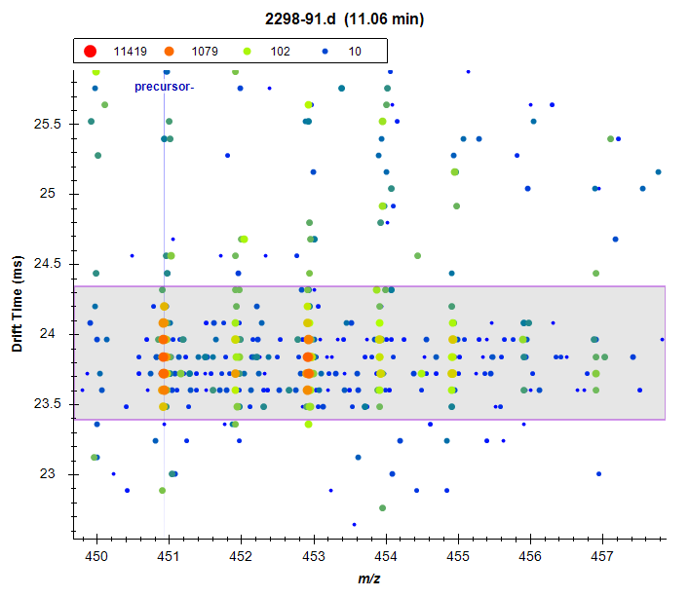
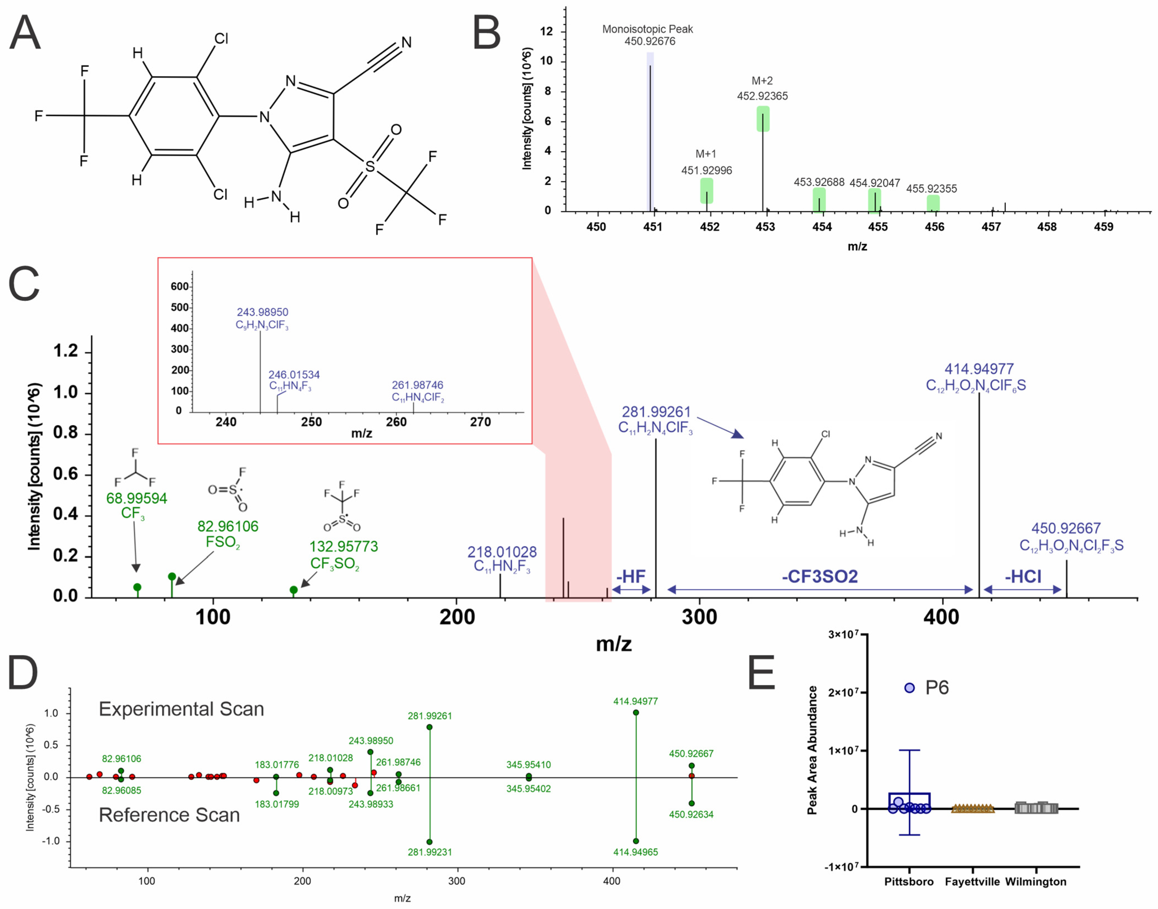
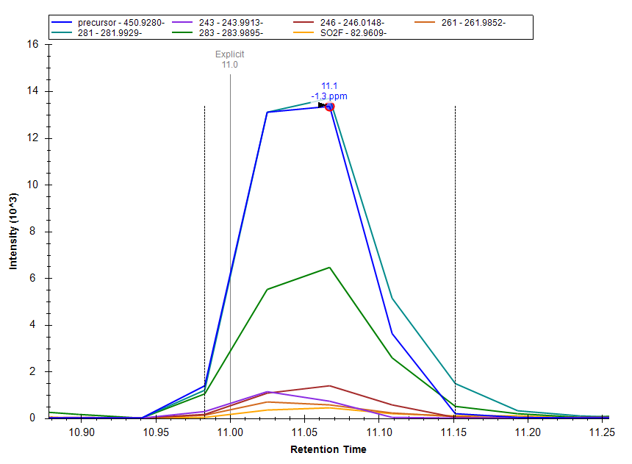
m/z 450.9280 structural elucidation
Weed et al. https://doi.org/10.3390/toxics12060403

Slide 15
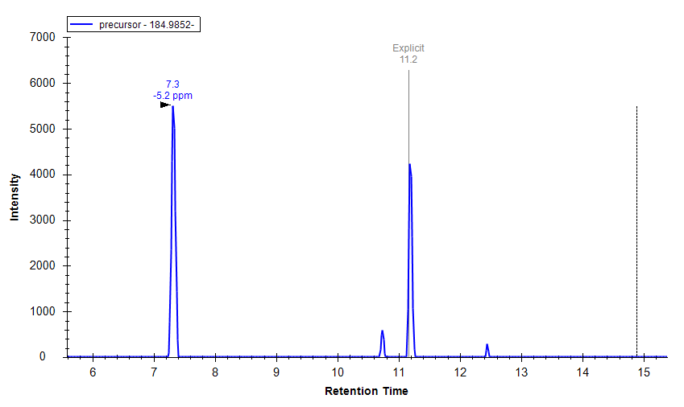
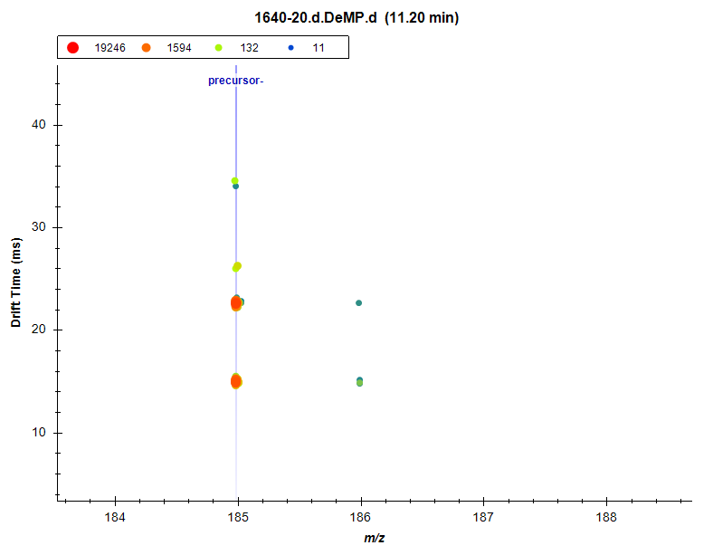
Feature ID# 1413: Not PMPA
m/z 184.985 and CCS 115.2 matched our library entry for PMPA, but RT should be 2.6 min
Multiple drift peaks indicates multimerization -> characteristic of ethers and carboxylic acids on our platform
HFPO-DA (GenX)
(or SIL)
No matching PFECAs in our library with this RT
HFPO-TrA
HFPO-TeA
Hypothesis: This is an in-source fragment of an undetected PFECA
Can we call this a Level 5?

Slide 16
Summary 1/2
2 previously-unreported (I think) PFAESAs (in homologous series with PFEESA)
2 novel PFAS (no matches in PubChem)
PFHxESA (Feature ID# 2318)
Confidence Level: 2
Molecular Formula: C₈HF₁₇O₄S
[M-H]-: 514.925131 Da
PFHpESA (Feature ID# 2857)
Confidence Level: 2
Molecular Formula: C₉HF₁₉O₄S
[M-H]-: 564.921938 Da
H-substituted polyfluorinated triether carboxylic acid
Confidence Level: 3
Molecular Formula: C₁₁H₂F₂₀O₅
[M-H]-: 592.9510 Da
H-substituted polyfluorinated triether sulfonic acid
Confidence Level: 3
Molecular Formula: C₁₀H₂F₂₀O₆S
[M-H]-: 628.9180 Da

Slide 17
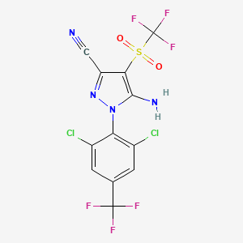
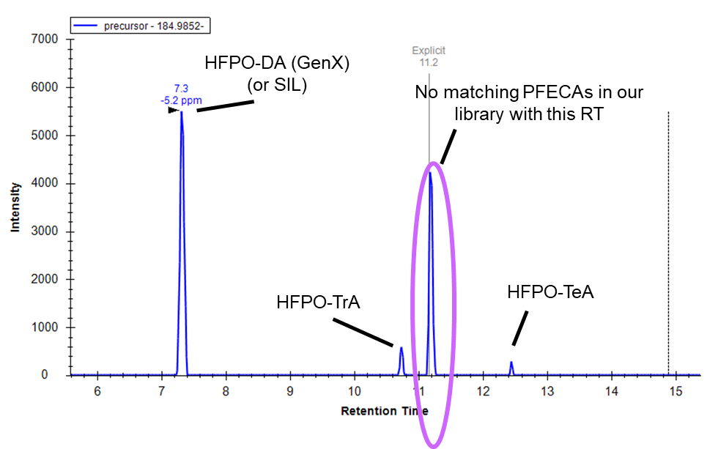
Summary 2/2
1 fluorinated insecticide
1 indication of an ether with no ether detected
2 PFAS that might be in source fragments or their own things
Fipronil sulfone
Confidence Level: 2
Molecular Formula: C12H4O2N4Cl2F3S
[M-H]-: 450.9258 Da
Undetected PFECA
Confidence Level: 5
Molecular Formula: C3F7O + R
[M-H]-: TBD
Feature ID# 1692
Confidence level: 5
Unidentified
Exact m/z match to PFEESA, wrong RT, wrong CCS
Feature ID# 5135
Confidence level: 3
Molecular formula: C8H2F16O3
[M-H]-: 448.9655
Drift aligned and perfectly coelutes with m/z 592.9495

Slide 18
Next steps
Decide how to report the possible in source fragments
Get relative abundances of all features (in our library and the novel ones) in Skyline
Explore site and year trends
Identify remaining features (if possible)
Write

Slide 19
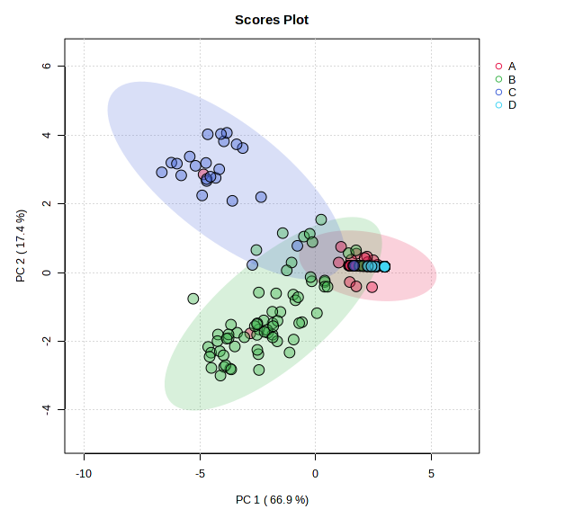
Initial comparison of feature abundances (new PFAS only)
Clear separation of sites B and C from each other and from A and D

Slide 20
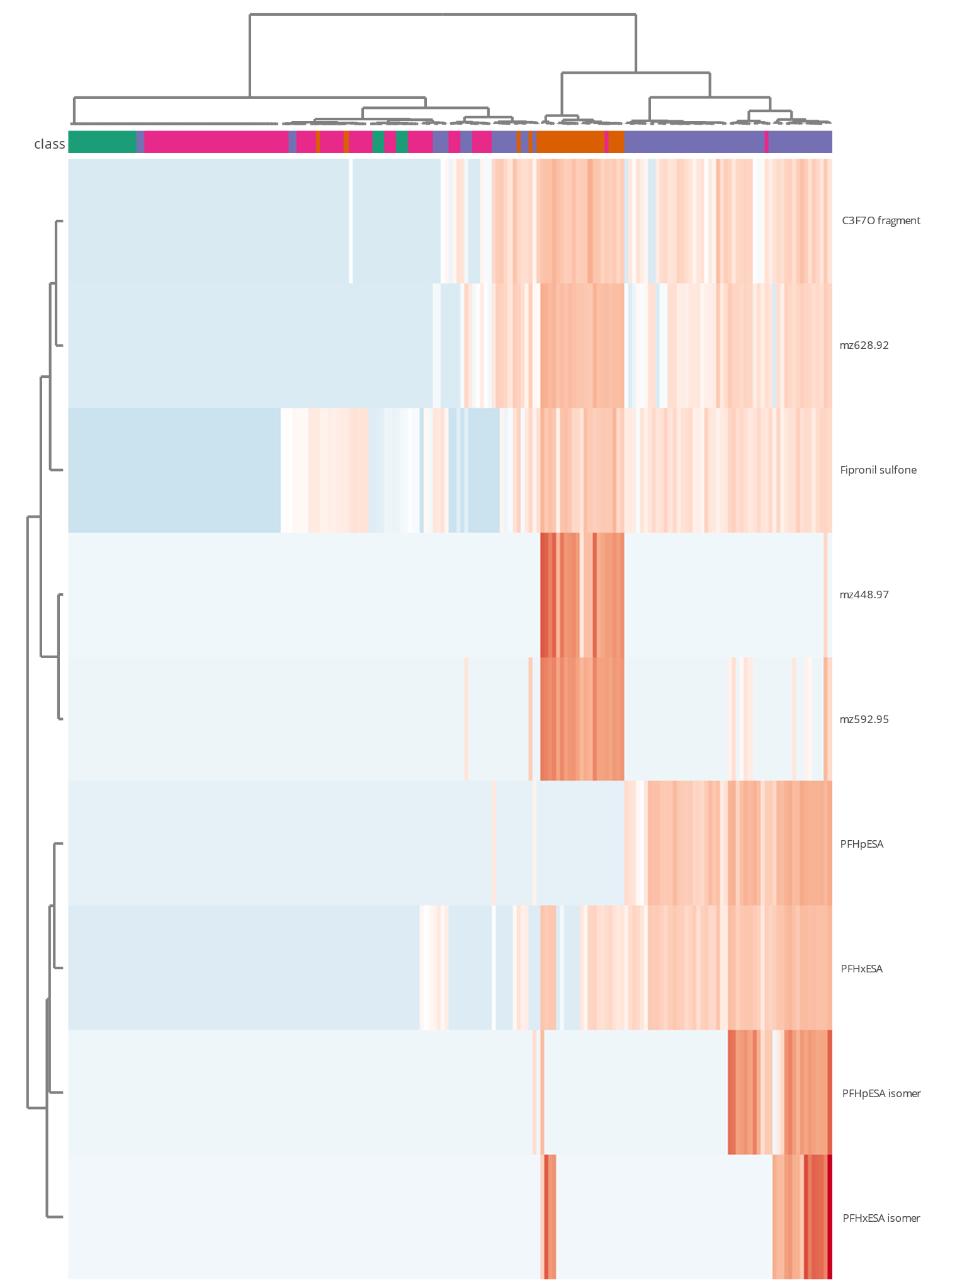
Site trends
A (Lake Waccamaw)
C3F7O-
B (Cape Fear)
C (Coastal NC)
m/z 628.92
D (Florida)
Fipronil sulfone
m/z 448.97
H-substituted polyfluoro triethers
Highest abundance in coastal animals
m/z 592.95
PFHpESA
Long chain PFAESAs
Higher abundance in CFR animals
PFHxESA
PFHpESA isomer
PFHxESA isomer

Slide 21
Sites A and B time trends

